Slide 1
Abacus
Group 9
Josh Overbeck
Jacob Sandy
Feiyu Wang
Nicole Matthews

Slide 2
Member Roles
Nicole - Login GUI, Backend
Josh - Backend
Feiyu - Testing
Jacob - Inventory GUI
All - Documentation

Slide 3
What is Abacus?
Abacus is an Inventory Management System used to help companies stay organized and regulate their inventories

Slide 4
Things Change...
Originally we were going to use a database to hold the inventory data but later realized that for ease of installation and use, a simple file of serialized objects stored locally would be more practical

Slide 5
Tools Used
Tools
Github
Eclipse
Scenebuilder
JUnit5
Google drive
Languages
Javafx
CSS
FXML

Slide 6
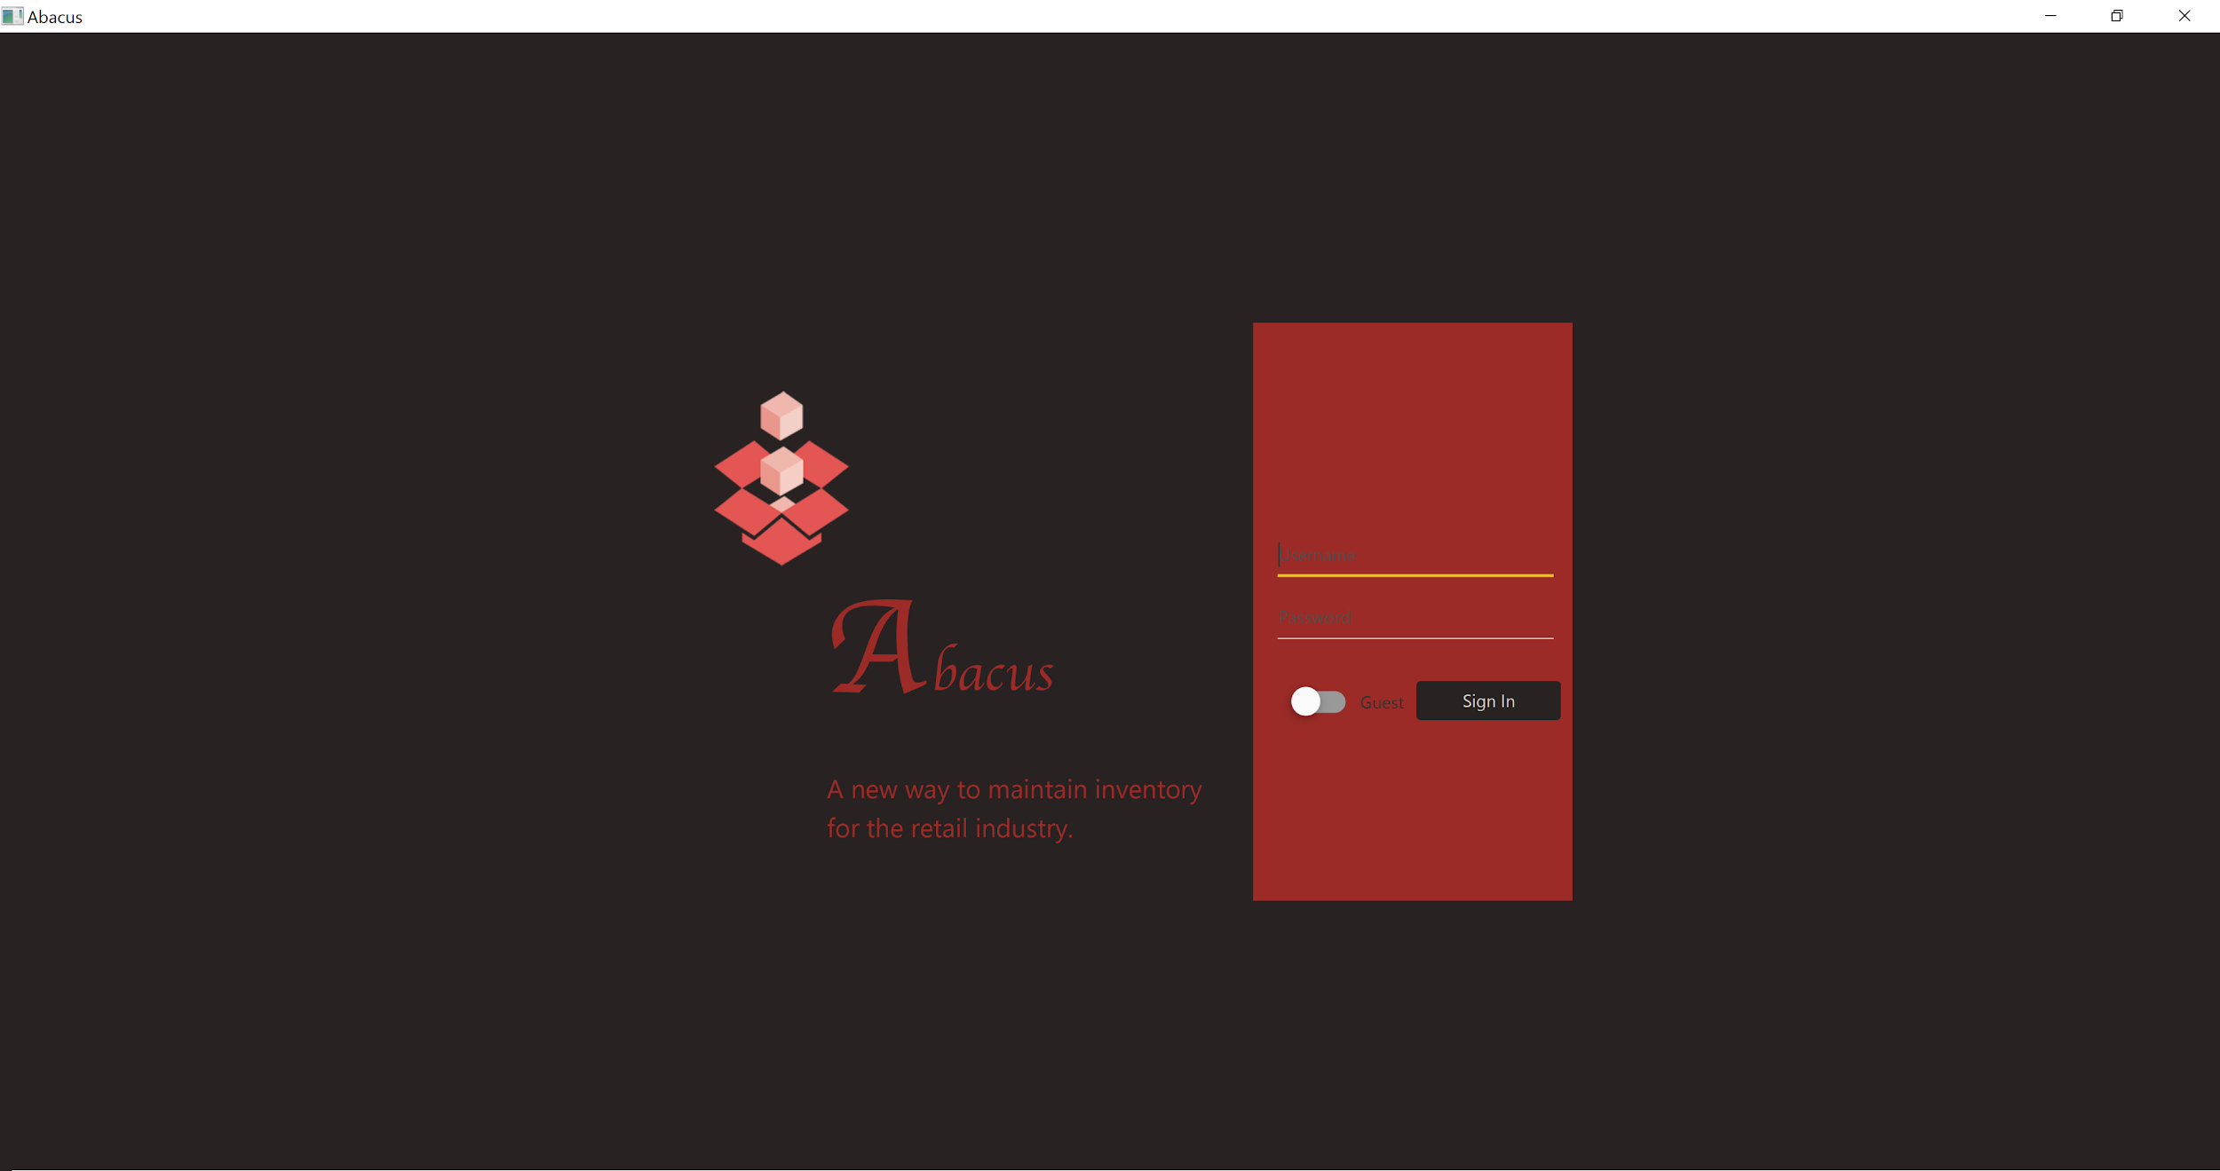
Place your screenshot here
Login Screen
Login with a username and password or as a guest

Slide 7
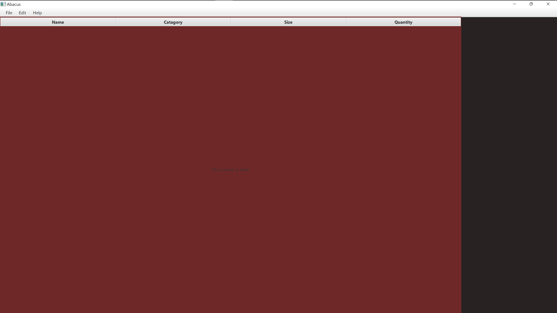
Place your screenshot here
Inventory Screen
From here, the user can view and sort the table

Slide 8
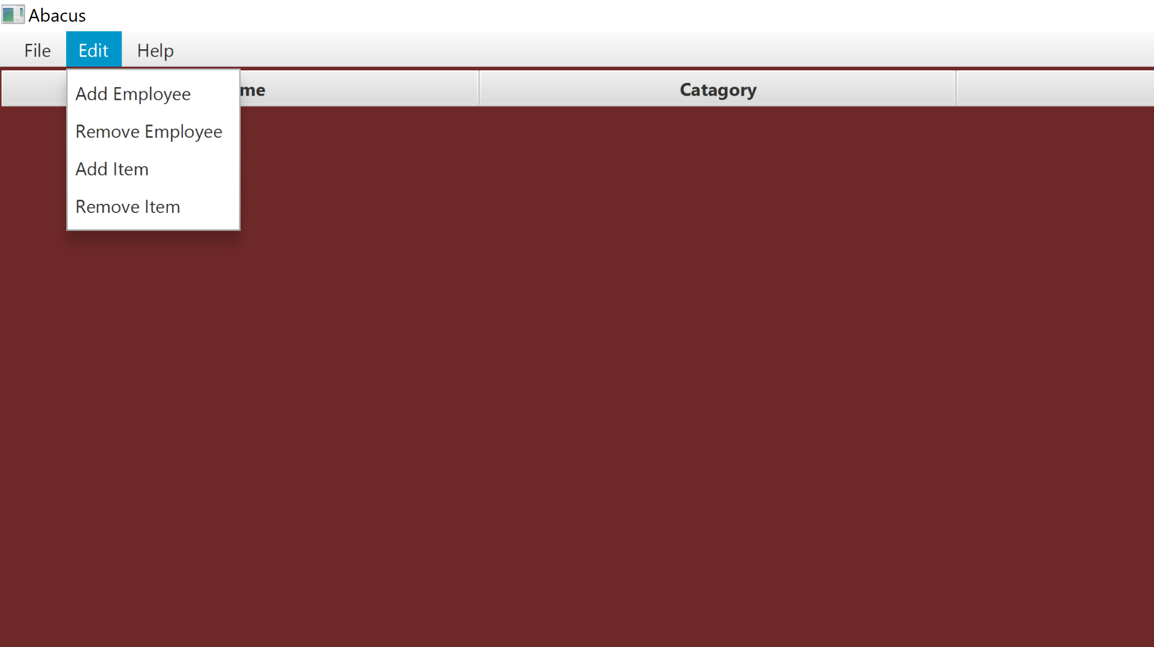
Place your screenshot here
Adding/Removing
To add items and employees, the user must be signed in

Slide 9
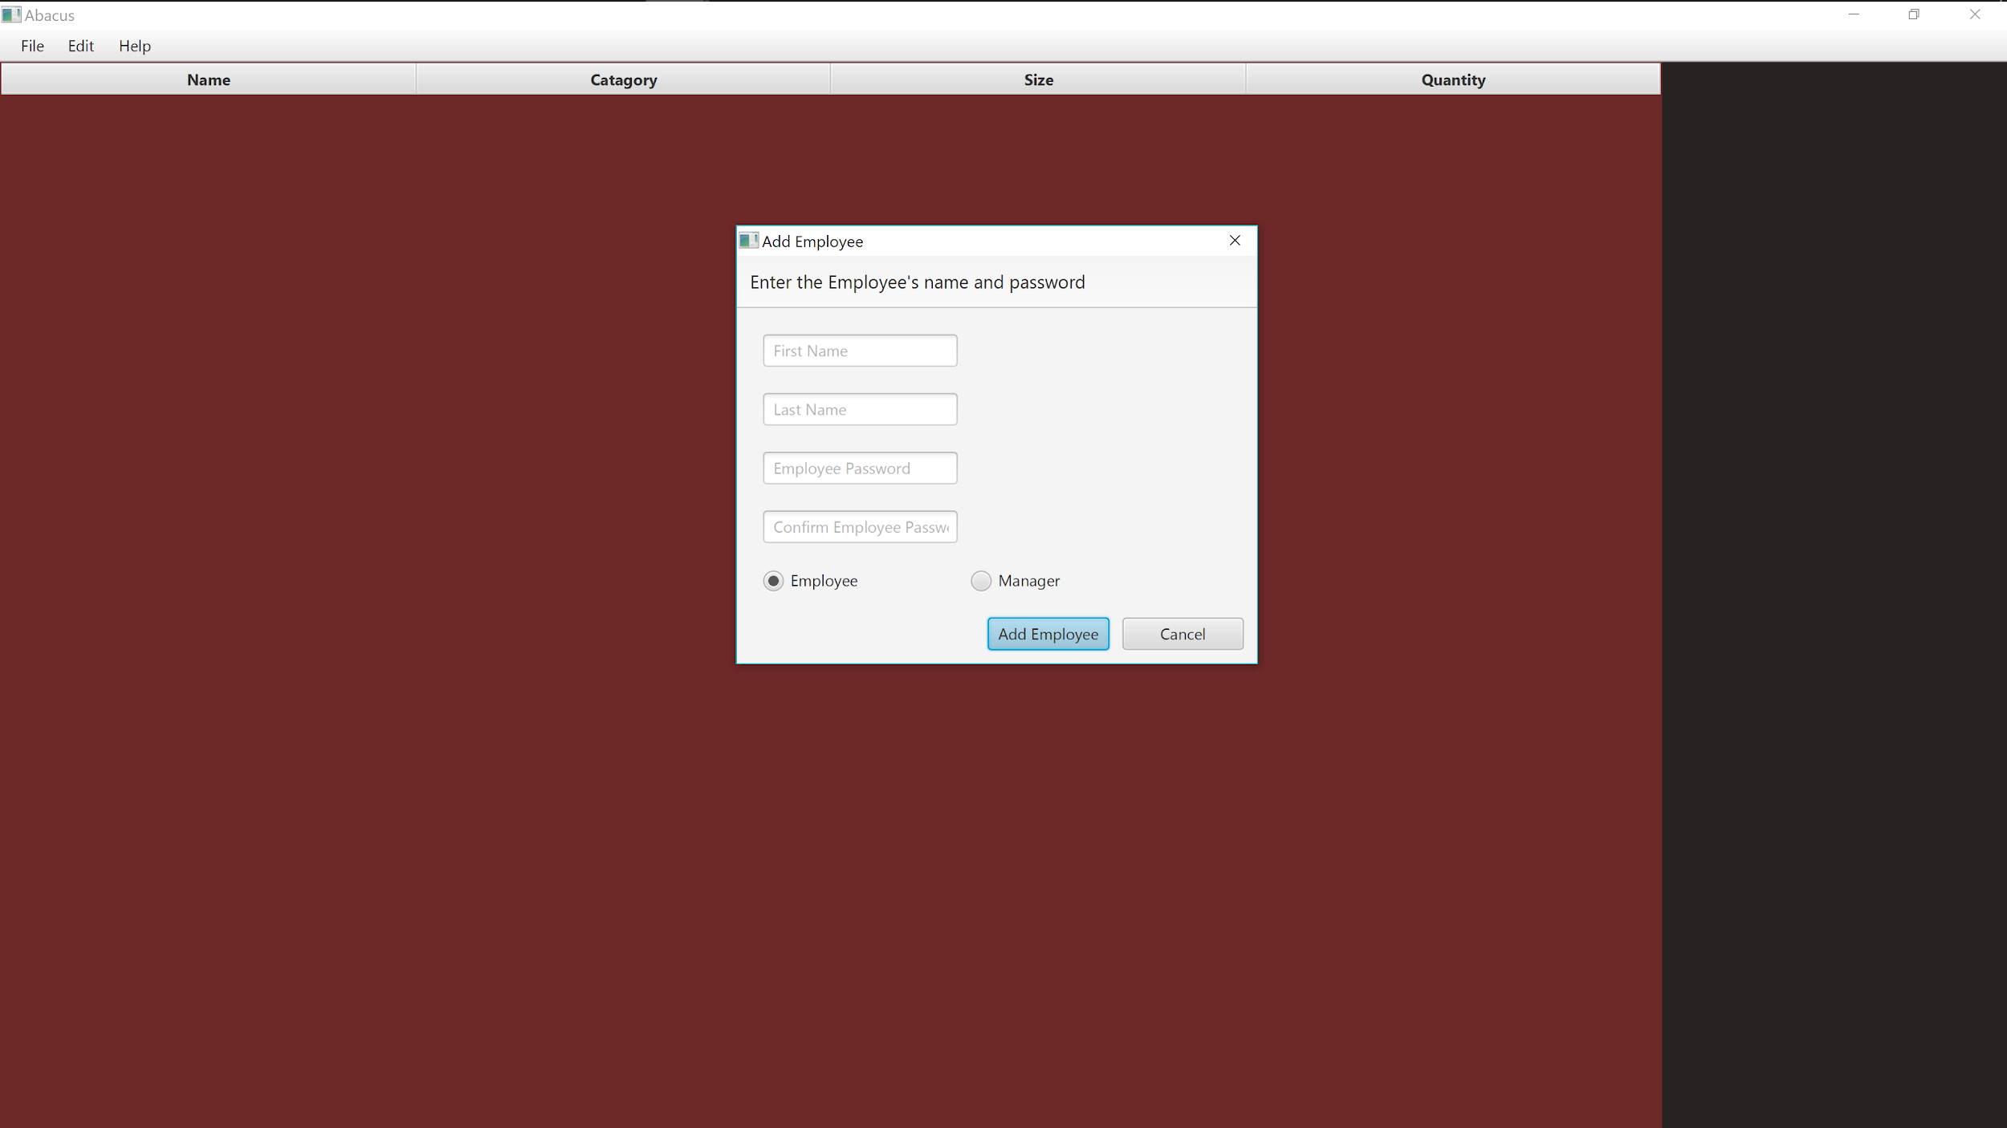
Place your screenshot here
Add Employee
Here managers and the admin are able to add a new employee and specify if they’re a Manager or Employee

Slide 10
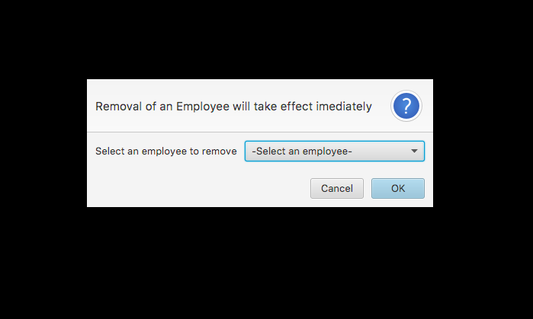
Place your screenshot here
Remove Employee
Here the managers and admin, is able to add a new employee and specify if they’re a Manager or Employee

Slide 11
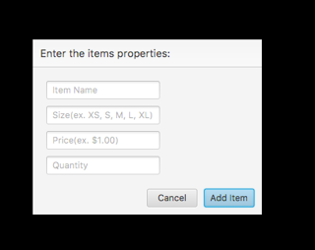
Place your screenshot here
Add Item
Logged in users can also add or delete items from the table

Slide 12
Still need to do
Remove item
Populating the table

Slide 13
Questions?

